Slide 1
Visual Analysis of Topic Competition
…
VAST 13
…
…
on Social Media
Panpan Xu¹, Yingcai Wu², Enxun Wei², Tai-Quan Peng³, Shixia Liu², Jonathan J.H. Zhu⁴, Huamin Qu¹
1 Hong Kong University of Science and Technology
2 Microsoft Research Asia
3 Nanyang Technological University
4 City University of Hong Kong
Notes:
Good afternoon, today I am going to present this paper, visual analysis of topic competition on social media
This is a collaborative work with dr …

Slide 2
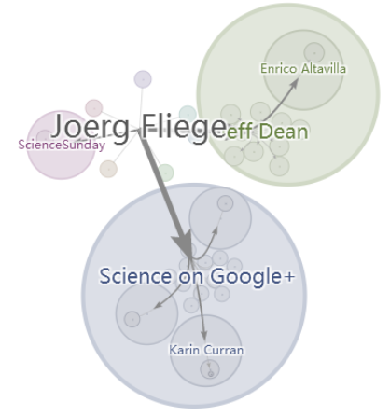
On Social Media:
Diffusion of multiple topics
The Interaction: Do people get distracted away from some topics when something more “eye-catching” is happening?
Google Ripples
The Influence: How do the opinion leaders (influential users) affect the interaction by recruiting the public attention for some topics?
INTRO / SYSTEM / MODEL / DESIGN / CASE STUDY
Notes:
Social media like twitter has greatly changed the ways that people digest news, in contrast to traditional media such as TV or newspaper, social media enabled large number of users to express their interests and opinions, and they can also possibly influence others through the follower / listener relations.
Social media also offers great opportunity to study various social phenomenon, such as the diffusion of information.
In this study, we take a closer look at how the multiple topics diffuses and gains popularity on social media
And specifically, we study the interaction among the topics, like how some (eye-catching) topics would distract people away from others.
And also how the influence happens for the opinion leaders on social media to affect the interaction among the topics

Slide 3
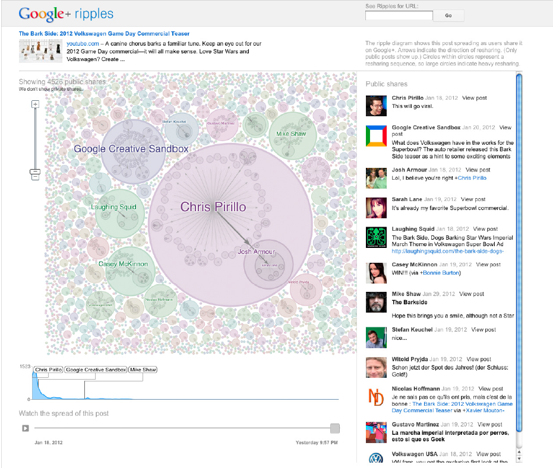
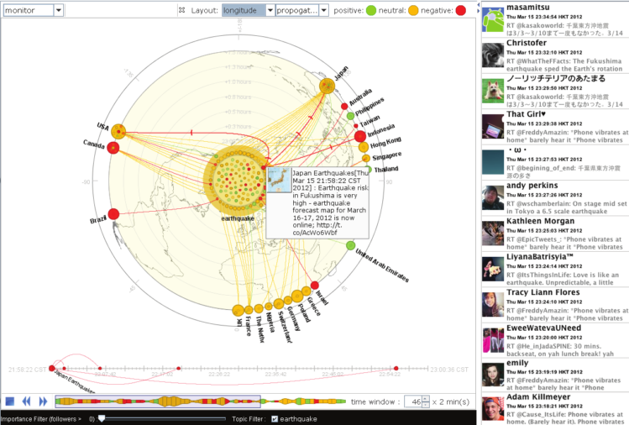
Google Ripples [F. Viégas et al. 11]
Whisper [N. Cao et al. 12]
INTRO / SYSTEM / MODEL / DESIGN / CASE STUDY
Notes:
These are some related works to visualize how information propagates on social media
That display the hierarchical structure of reposts,
or
the spatial temporal characteristics of the propagation of a topic.
Which are more of a macroscopic view
We try to look at the diffusion of information at a larger scale
And model and visualize how multiple topics interact
and compete for the collective attention of the public
when they simultaneously propagates on social media.

Slide 4
Agenda-setting
The ability of the news media (e.g. TV and newspaper) to influence the salience of topics on the public agenda.
[M. E. McCombs
and D. L. Shaw 72]
Topic competition
The addition of any new topic onto the public agenda comes at the cost of other topic(s).
[J. Zhu 92]
Two-step information flow
The information reaches the masses via intermediaries.
[S. Wu et.al 11]
INTRO / SYSTEM / MODEL / DESIGN / CASE STUDY
Notes:
Our work is grounded in several theories and concepts in traditional and social media study.
The first one is agenda setting theory,
which states that how the emphasize of certain topics on traditional media such as news papers, televisions will affect the collective attention of public on that topic.
For example: if some news is put on the headline of some newspapers,
it would be likely to raise the awareness of people on that topic

Slide 5
Agenda-setting
The ability of the news media (e.g. TV and newspaper) to influence the salience of topics on the public agenda.
[M. E. McCombs
and D. L. Shaw 72]
Topic competition
The addition of any new topic onto the public agenda comes at the cost of other topic(s).
[J. Zhu 92]
Two-step information flow
The information reaches the masses via intermediaries.
[S. Wu et.al 11]
INTRO / SYSTEM / MODEL / DESIGN / CASE STUDY
Notes:
In agenda-setting study, researchers have also tested the hypothesis that people could pay attention to a limited amount of topics at the same time and the topics have to compete for the limited collective public attention.

Slide 6
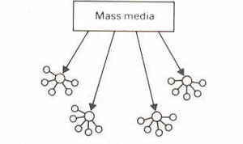
Agenda-setting
The ability of the news media (e.g. TV and newspaper) to influence the salience of topics on the public agenda.
[M. E. McCombs
and D. L. Shaw 72]
Topic competition
The addition of any new topic onto the public agenda comes at the cost of other topic(s).
[J. Zhu 92]
Two-step information flow
The information reaches the masses via intermediaries (opinion leaders).
[S. Wu et al. 11]
INTRO / SYSTEM / MODEL / DESIGN / CASE STUDY
Notes:
the two-step information flow states
that the information reaches the mass in a staged process
with an intermediate layer of opinion leaders which could affect the flow of information
This has been noted for both traditional media and social media

Slide 7
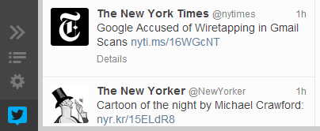
Combine quantitative modeling and interactive visualization
Healthcare
Extract time varying measurements on
topic competitiveness
each opinion leader group’s influence on each topic
topic transition trend of each opinion leader group
#china
#debate
Visualize
the dynamic relation between topics and opinion leader groups
textual contents of the posts
INTRO / SYSTEM / MODEL / DESIGN / CASE STUDY
Notes:
Based on these theories and the corresponding assumptions,
we try to combine … and …. for the analysis of large volume of social media data.
Through time series modeling techniques, we extract …..
and the topic transition trend, like how the people switch their attention from one topic to another
The interactive visualize system that shows the dynamic ….
And visually summarize the textual contents of the posts to explain the dynamic trend.

Slide 8
Combine quantitative modeling and interactive visualization
Topic Transition Analysis
Timeline
Visualization
Word Cloud
Topic
Topic Competition Modeling
User group
Raw Tweets List
Time Series:
Stream of tweets
Text Search
Collection of Tweets
INTRO / SYSTEM / MODEL / DESIGN / CASE STUDY
Notes:
This figure basically shows how all the stuff work

Slide 9
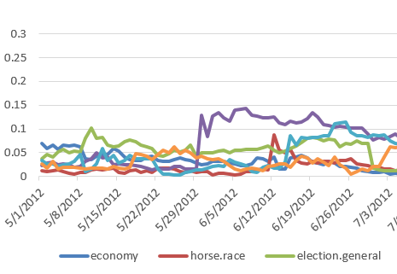
Combine quantitative modeling and interactive visualization
Topic Transition Analysis
Timeline
Visualization
Word Cloud
Topic
Topic Competition Modeling
User group
Raw Tweets List
Time Series:
Stream of tweets
Text Search
Collection of Tweets
INTRO / SYSTEM / MODEL / DESIGN / CASE STUDY
Notes:
First we start from a collection of tweets on top of which we utilize an efficient text search engine
to collect
streams of tweets that are posted by a certain group of users on a certain topic.

Slide 10

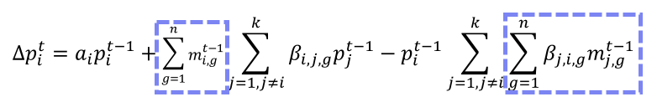
Combine quantitative modeling and interactive visualization
Topic Transition Analysis
Timeline
Visualization
Word Cloud
Topic
Topic Competition Modeling
User group
Raw Tweets List
Time Series:
Stream of tweets
Text Search
Time-varying topic competitiveness
Each opinion leader group’s influence
Topic transition trend
Collection of Tweets
INTRO / SYSTEM / MODEL / DESIGN / CASE STUDY
Notes:
We analyze the changing volume of the tweet streams then.
The results is a set of measurement on ….

Slide 11
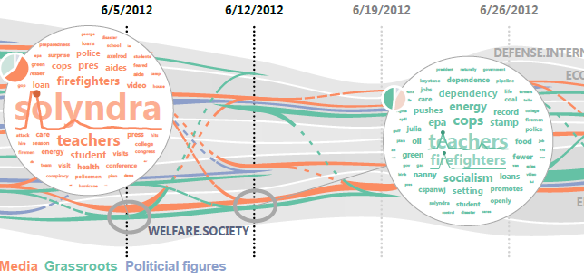
Combine quantitative modeling and interactive visualization
Topic Transition Analysis
Timeline
Visualization
Word Cloud
Topic
Topic Competition Modeling
User group
Raw Tweets List
Time Series:
Stream of tweets
Text Search
Collection of Tweets
INTRO / SYSTEM / MODEL / DESIGN / CASE STUDY
Notes:
After the modeling and analysis have been done.
The information including the dynamic relation between the opinion leaders and the topics and the competitiveness of the topics will be displayed in a timeline visualization,
Which is linked to two other views : the word cloud and the raw tweets list, that will allow the users to further investigate reasons behind the temporal trends

Slide 12
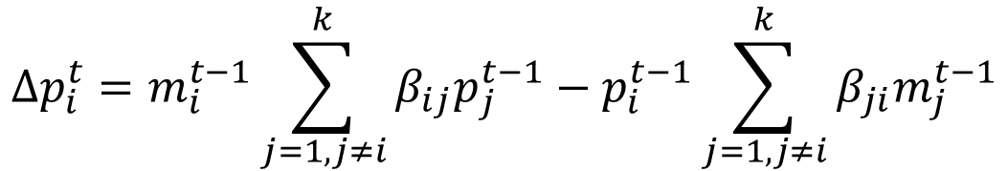
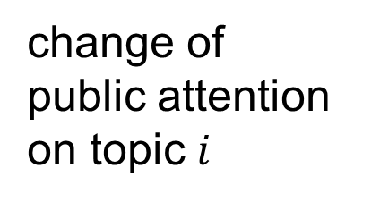
Topic Competition Model for traditional media:
recruiting effect
distraction effect
change of
public attention on topic $i$
$$∆p_{i}^{t}=m_{i}^{t−1}\sum_{j=1, j≠i}^{k}{β_{ij}p_{j}^{t−1}}−p_{i}^{t−1}\sum_{j=1, j≠i}^{k}{β_{ji}m_{j}^{t−1}}$$
[J. Zhu 92]
INTRO / SYSTEM / MODEL / DESIGN / CASE STUDY
Notes:
I will start from the topic competition model
Our model is an extension of a topic competition model on traditional media.
It is a time series model states that
the change in the amount of public attention on a topic i
results from two competing effects

Slide 13
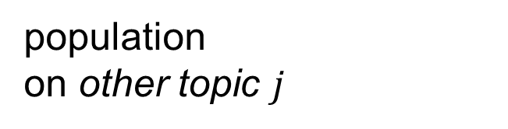
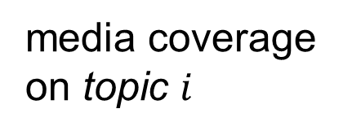
Topic Competition Model for traditional media:
recruiting effect
change of
public attention on topic $i$
$$∆p_{i}^{t}=m_{i}^{t−1}\sum_{j=1, j≠i}^{k}{β_{ij}p_{j}^{t−1}}−p_{i}^{t−1}\sum_{j=1, j≠i}^{k}{β_{ji}m_{j}^{t−1}}$$
media coverage
on topic $i$
population
on other topic $j$
[J. Zhu 92]
INTRO / SYSTEM / MODEL / DESIGN / CASE STUDY
Notes:
Recruiting effect
Is that
the media coverage on issue i recruits people who are originally interested in some other issue j,

Slide 14
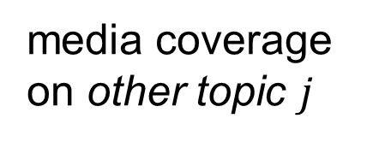
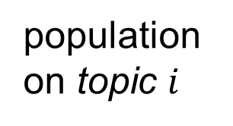
Topic Competition Model for traditional media:
distraction effect
change of
public attention on topic $i$
$$∆p_{i}^{t}=m_{i}^{t−1}\sum_{j=1, j≠i}^{k}{β_{ij}p_{j}^{t−1}}−p_{i}^{t−1}\sum_{j=1, j≠i}^{k}{β_{ji}m_{j}^{t−1}}$$
media coverage
on other topic $j$
population
on topic $i$
[J. Zhu 92]
INTRO / SYSTEM / MODEL / DESIGN / CASE STUDY
Notes:
The distraction effect
Is how
the media coverage on other issue j distracts people who are originally interested in issue i.

Slide 15

The Extended Topic Competition Model:
Two step information flow
Heterogeneous influence (news media, grassroots)
$$∆p_{i}^{t}=m_{i}^{t−1}\sum_{j=1, j≠i}^{k}{β_{ij}p_{j}^{t−1}}−p_{i}^{t−1}\sum_{j=1, j≠i}^{k}{β_{ji}m_{j}^{t−1}}$$
$$\sum_{g=1}^{n}{m_{i,g}^{t−1}}$$
INTRO / SYSTEM / MODEL / DESIGN / CASE STUDY
Notes:
On social media , the situation could be more complex. instead of a single media coverage term, we now have a set of different types of opinion leaders who could be politicians, grassroots, or the accounts of traditional media on social media such as cnn or nyt, this also accounts for the two step information flow.
So the original model , which contains a single influence source which is the mass media
Is replaced by a set of different opinion leader groups on social media

Slide 16
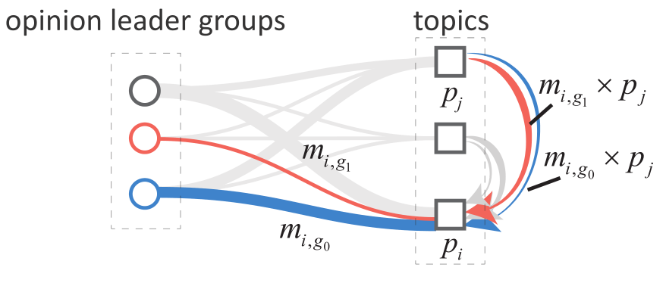
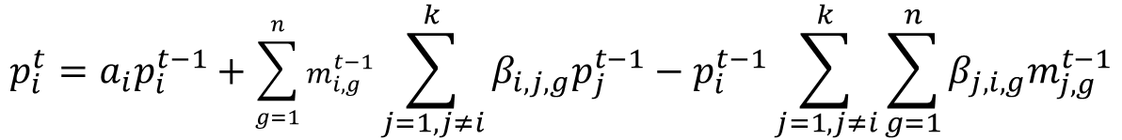
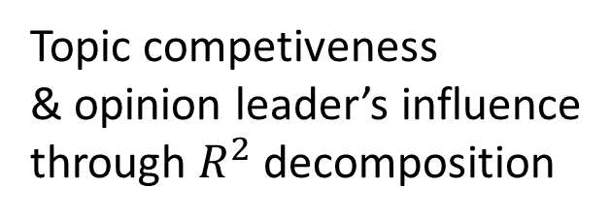
The Extended Topic Competition Model:
Two step information flow
Heterogeneous influence (news media, grassroots)
$$p_{i}^{t}=a_{i}p_{i}^{t−1}+\sum_{g=1}^{n}{m_{i,g}^{t−1}}\sum_{j=1, j≠i}^{k}{β_{i,j,g}p_{j}^{t−1}}−p_{i}^{t−1}\sum_{j=1, j≠i}^{k}{\sum_{g=1}^{n}{β_{j,i,g}m_{j,g}^{t−1}}}$$
Topic competiveness
& opinion leader’s influence
through $R^{2}$ decomposition
recruiting effect
distraction effect
INTRO / SYSTEM / MODEL / DESIGN / CASE STUDY
Notes:
So this is the extended topic competition model on social media.
It takes into account the heterogeneous influence sources in social media
There are recruiting term and distraction term, and also additionally an auto-regression term
The competitiveness of a topic and the influence or the recruitment effect of a particular opinion leader group on that topic is obtained through r square decomposition
The topic competitiveness is how much variance in the popularity of a topic is accounted by the recruiting term in the equation.

Slide 17

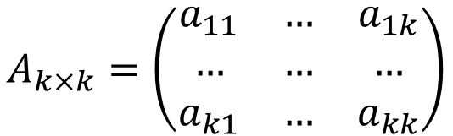







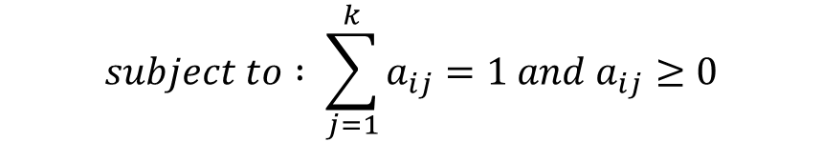

T-1
T
Topic Transition Estimation
topic $1$
topic $1$
…
$$A_{k×k}=\left(\begin{matrix}a_{11} & … & a_{1k} \\ … & … & … \\ a_{k1} & … & a_{kk}\end{matrix}\right)$$
…
Transition matrix
topic $i$
topic $j$
…
…
$$\min{\sum_{l}{ω_{l}{\left\|m_{l}^{t−1}A−m_{l}^{t}\right\|}^{2}}}$$
topic $k−1$
topic $k−1$
$$subject to : \sum_{j=1}^{k}{a_{ij}}=1 and a_{ij}≥0$$
topic $k$
topic $k$
INTRO / SYSTEM / MODEL / DESIGN / CASE STUDY
Notes:
The second part of the quantitative modeling approach concerns about how the opinion leaders shift their attention among the topics.
While for a single user, we could hardly say exactly how much of his attention transits from a topic I to a topic j, it is possible to estimate a transition trend for a group of users,
When there are k topics, the overall transition trend among adjacent time steps can be described mathematically as a matrix with k times k entries.
entry ij is the amount of transition from topic i to j
The value of the entries and row sum of the entries are subjected to constraints.
And we estimate the entry of the matrix through a least squares formulation.

Slide 18
Output of Analysis and Modeling Step:
Time varying competitiveness of each topic
Time varying opinion leader groups’ influence on each topic
The topic transition trend of the opinion leader groups between adjacent time stamps.
Topic Transition Analysis
Timeline
Visualization
Word Cloud
Topic
Topic Competition Modeling
User group
Raw Tweets List
Time Series:
volume of tweets
Text Search
Collection of Tweets
INTRO / SYSTEM / MODEL / DESIGN / CASE STUDY
Notes:
After the quantitative modeling of
topic competition
topic transition
a set of metrics and time varying relations between the opinion leader groups and the topics.
But how can we make it easier to grab all the time varying relation and information at a time?
,

Slide 19
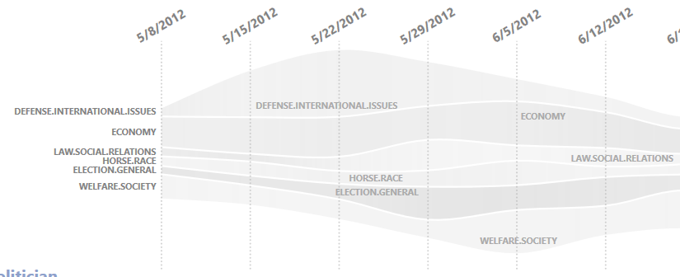
Topic competiveness
Timeline view
INTRO / SYSTEM / MODEL / DESIGN / CASE STUDY
Notes:
We designed a timeline visualization to synthesis the related information
The time varying competitiveness of the topics are represented with a theme river at the background.
The overall height of the theme river shows added up the competitiveness and shows how fierce the competition is like.

Slide 20
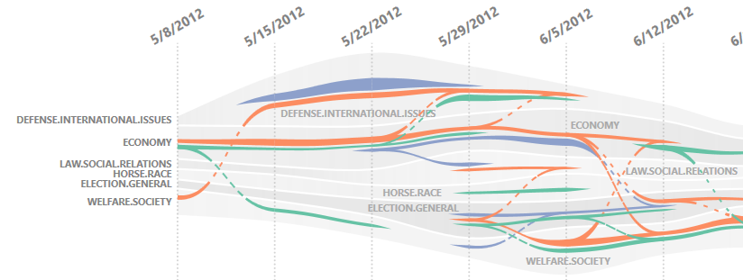
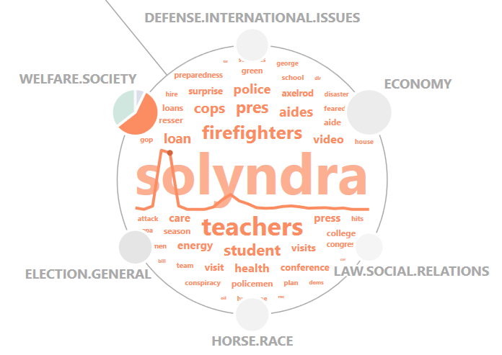
Topic competiveness
+ Recruitment effect of different opinion leaders
Media
+ Topic transition trend
Political Figures
Grassroots
Timeline view
Word Cloud
INTRO / SYSTEM / MODEL / DESIGN / CASE STUDY
Notes:
On top of the ThemeRiver,
we draw colored threads which represent the recruitment effect of the opinion leaders
With the thickness of the thread denoting the strength of the recruitment effect
Thread that goes from one layer in the themeriver to another
represent the topic transition trends, with the density of the dots on the curve being proportional to the estimated amount of transition.
we see how the roles of the opinion leaders differs and converges along the timeline as they affect on the topics.
A word cloud is displayed on demand to show the textual contents of the tweets.

Slide 21
Word cloud filterable by:
Topic
Time interval
Opinion leader group
Sparkline:
Time varying saliency of a word
INTRO / SYSTEM / MODEL / DESIGN / CASE STUDY
Notes:
The word cloud allow for exploration of the content of the tweets by filtering from different dimensions
And we implement mechanisms to filter the textual contents though time interval, through related topics,
and opinion leader group
a sparkline could be displayed on the word on demand to show the temporal varying saliency of that keyword.
Multiple word cloud could be pinned on the display to allow the comparison of textual contents across topics , time intervals, and user groups.

Slide 22
Dataset:
2012 Presidential Election; 89, 174, 308 tweets; May 01 – Nov 10
Six general topics : welfare/society, defense/international issues, economy, election (general), election (horse race), law/social relations *
Three opinion leader groups: media , political figures, and grassroots *
*identified collaboratively with media researchers
INTRO / SYSTEM / MODEL / DESIGN / CASE STUDY
Notes:
We use our system to perform a case study on a collection of tweets which is related to the 2012 presidential election.
There are ninety million tweets in total and the time ranges from may to nov
We identified six general topics and three different types of opinion leaders together with the media researchers.
*explain what the topic means
*give some examples of the opinion leaders in each group
The six topics include welfare/society,
and ….
The three different opinion leader groups include…
Media accounts on twitter: New York Times
Political figures: Obama, white house, …
Grassroots:

Slide 23
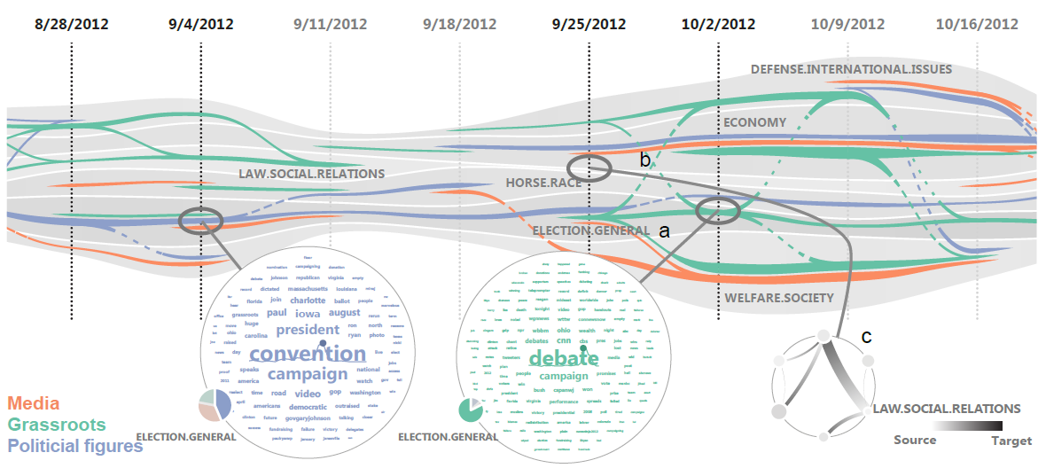
Election (general)
INTRO / SYSTEM / MODEL / DESIGN / CASE STUDY
Notes:
With the interactive visual analysis system,
we have some observations on how the topics compete , how the opinion leader groups recruit attention for the
and what could be the related events.
I will show some example here.
First , we can observe that in early September, there is a strong recruiting effect for the political figures on the topic election (general), as shown by the blue thread.
So we bring up the word cloud, to see what are they talking about, and find that this is very much related to the nation convention of republicans and democrats that take place during the time.

Slide 24
INTRO / SYSTEM / MODEL / DESIGN / CASE STUDY
Notes:
From this figure, we can see that the grassroots, as denoted by the green threads, got related to multiple topics around early october, and this may due to the occurrence of presidential debate that take place around that time.

Slide 25
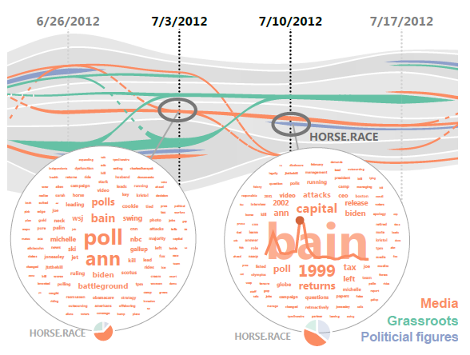
INTRO / SYSTEM / MODEL / DESIGN / CASE STUDY
Notes:
From this part of the timeline, we can see that ...
The media exerts a longtime of influence on the topic of horse race.
But with different related discussions

Slide 26
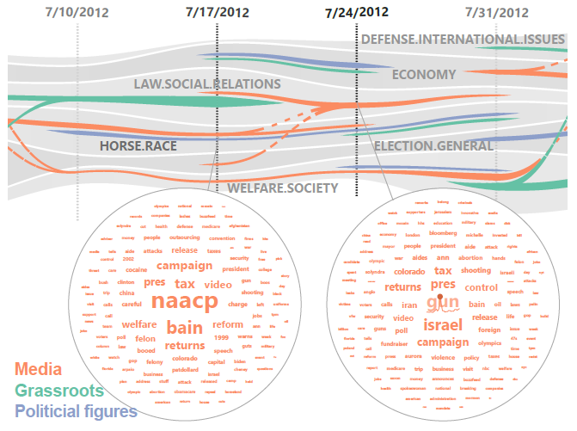
INTRO / SYSTEM / MODEL / DESIGN / CASE STUDY
Notes:
Around the end of july,

Slide 27
Visual analysis framework:
Topic Transition Analysis
Timeline
Visualization
Word Cloud
Model the topic competition on social media, the influence of opinion leader groups, and the topic transition trends.
Topic
Topic Competition Modeling
User group
Raw Tweets List
Time Series:
volume of tweets
Text Search
Visualize the results of the models and allow for further exploration to form explanations.
Collection of Tweets
SUMMARY / LIMITATIONS & FUTURE WORK

Slide 28
Manual process to collect keywords and categorize opinion leaders
more efficient ways?
Time series modeling
+ the structural factors of social network ?
Competition & cooperation
other modes of interaction among topics?
SUMMARY / LIMITATIONS & FUTURE WORK

Slide 29
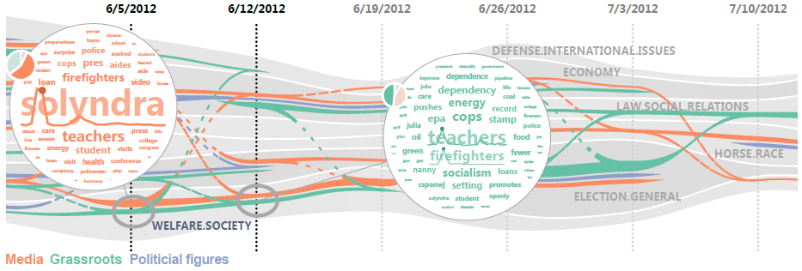
Thank You for Attention !

